Slide 1
Customer Churn Predictor A machine learning prediction engine for customer churn analysis
Siqi Li
June 8, 2020

Slide 2
Motivation
Motivation:
Customer attrition is undesirable, as in most of the cases, the cost to retain a customer is lower than that to acquire a new customer.
Goal:
Help a telecom company make reliable predictions for customer churn.
Company can implement remedial actions for customer retention.

Slide 3
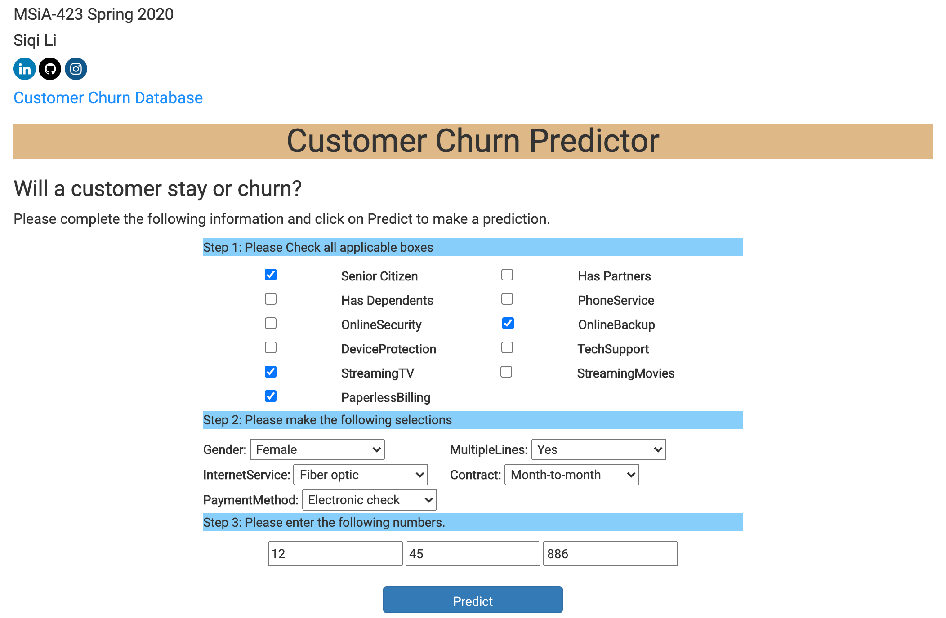
Live Demo
Place your screenshot here

Slide 4
Dataset
Information about a telecom company which provides services to customers in California.
From Kaggle.com
7, 043 observations
Binary Response Variable: Churn (Yes/No)
20 features including: Gender, Monthly charges, Contract type, Payment Methods

Slide 5
Model
Random Forest Classifier
80% Training set; 20 % Test set
Success criteria
Model performance metric
Accuracy on the test set: 81.02%; AUC: 0.8346 (Goal Achieved!)
Business outcome metrics:
10% decrease in customer attrition rate in the month

Slide 6
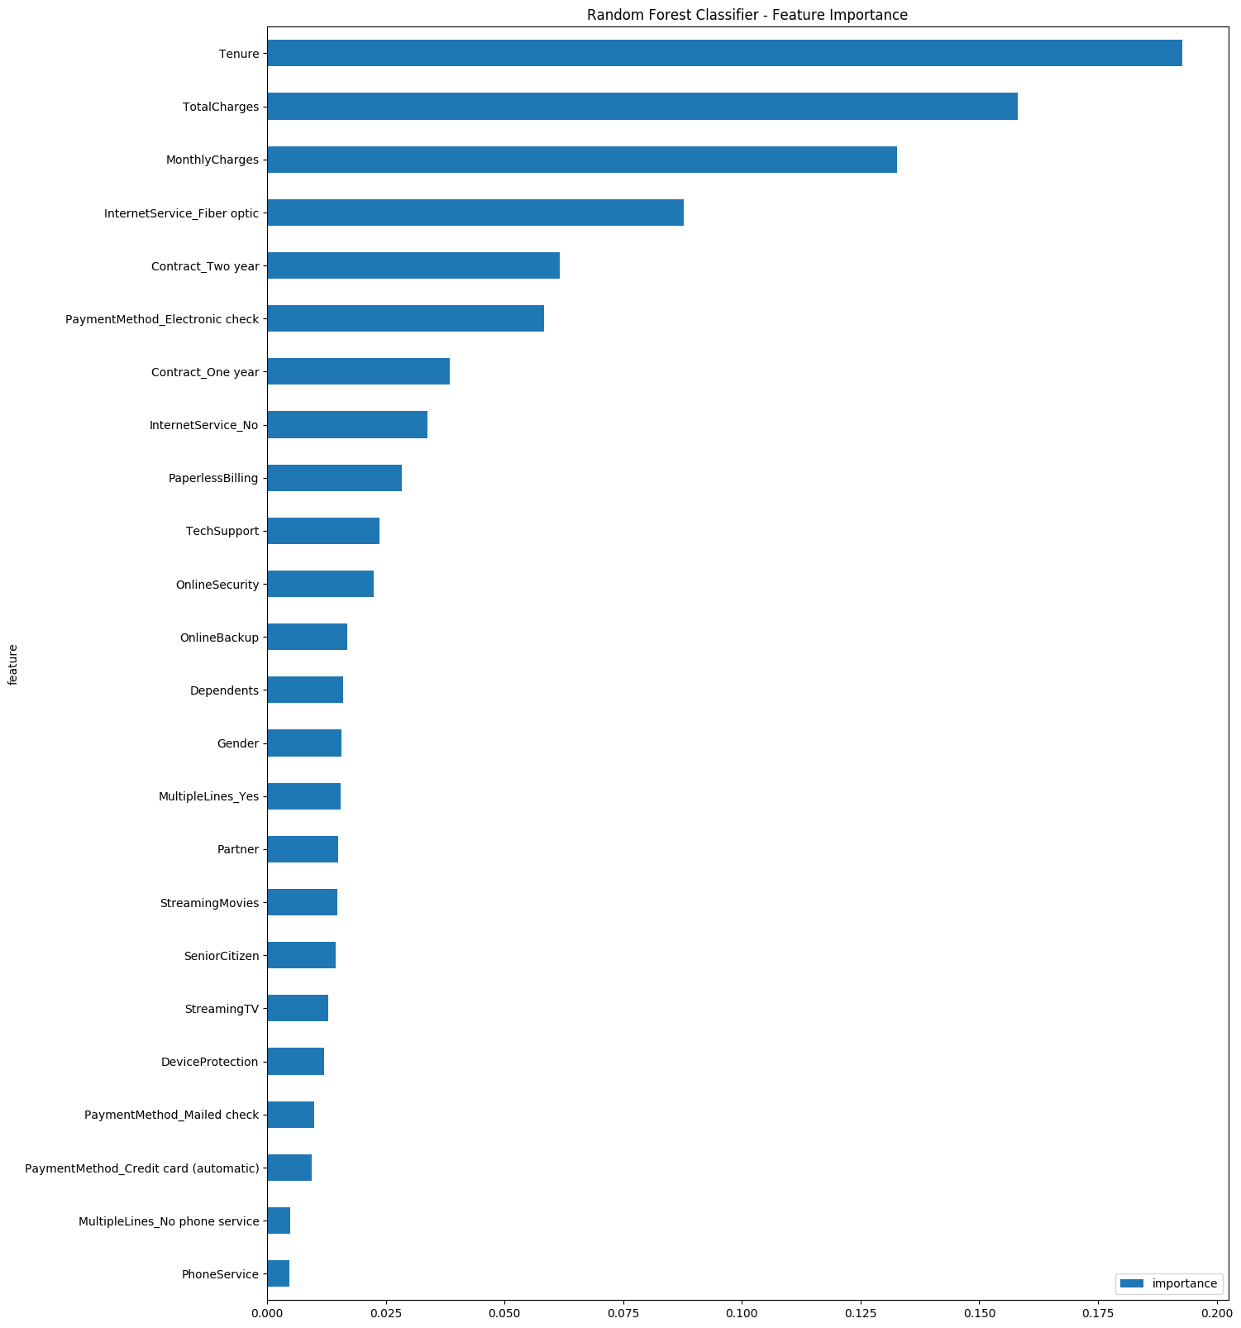
Insights
Tenure, Total Charges, Monthly Charges, Contact Type and Internet Service are the top 5 most important features.
Female and male are equally likely to churn.
Customer with Paperless Billing service are more likely to churn (74.9% among churn customers vs.53.6% non-churn customer)

Slide 7

Thanks!
Siqi Li
Northwestern MSiA Class of 2020
Email: siqi.li15@gmail.com
Github: https://github.com/LSQI15/2020-msia423-Li-Siqi

